Slide 1
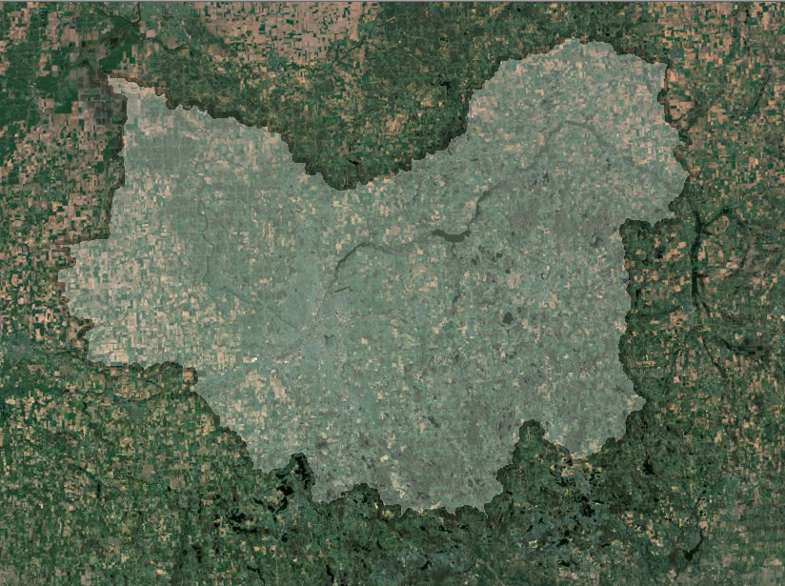
ELUCID Decision Support System and Field-Scale Analysis
May 7, 2014
Prepared by the Michigan State University
Institute of Water Research

Slide 2
Outline for Today
ELUCID overview and walkthrough
Break
ELUCID tutorial
Lunch on your own
GLWMS overview and walkthrough
Break
GLWMS tutorial
Wrap up and evaluation

Slide 3
Context
Flint River Nutrient Reduction: Focusing Action
GLRI Grant- focus on Swartz and Kearsley Creek watersheds
Achieving a larger impact on non-point source (NPS) pollution than using other approaches
Enhanced technical assistance
Accelerated BMP implementation
Reduced non-point source pollution
Notes:
The Institute of Water Research (IWR) at Michigan State University was awarded a Great Lakes Restoration Initiative grant from the EPA to develop a spatial decision support system to aid conservation technicians in implementing conservation practices in the Saginaw Bay Watershed. The grant was awarded to enhance technical expertise to reduce soluble reactive phosphorus. The grant also seeks to incorporate the mapping technology into classrooms conducting water quality monitoring projects. Two subwatersheds in the Flint River watersheds were targeted by the grant: Swartz and Kearsley Creeks. The project also has an Advisory Team that has provided a lot of feedback into the system you’ll be seeing this morning.
The project seeks to achieve a larger beneficial impact on agricultural non-point source (NPS) pollution than would be attained using current approaches.
The tools being covered in the training have a long history associated with them. ELUCID was originally developed for a project in Ottawa County. The IWR has since customized the system for use in the Flint River watershed. The Advisory Team developed five of the themes utilized in ELUCID and participated in evaluation workshops earlier this year to improve the system. The Field-scale Analysis Calculator was developed with support from the US Army Corps of Engineers and The Nature Conservancy. The Institute is always open to explore future opportunities with ELUCID.

Slide 4
Advisory Committee
Notes:
Designed to have ongoing feedback from users

Slide 5
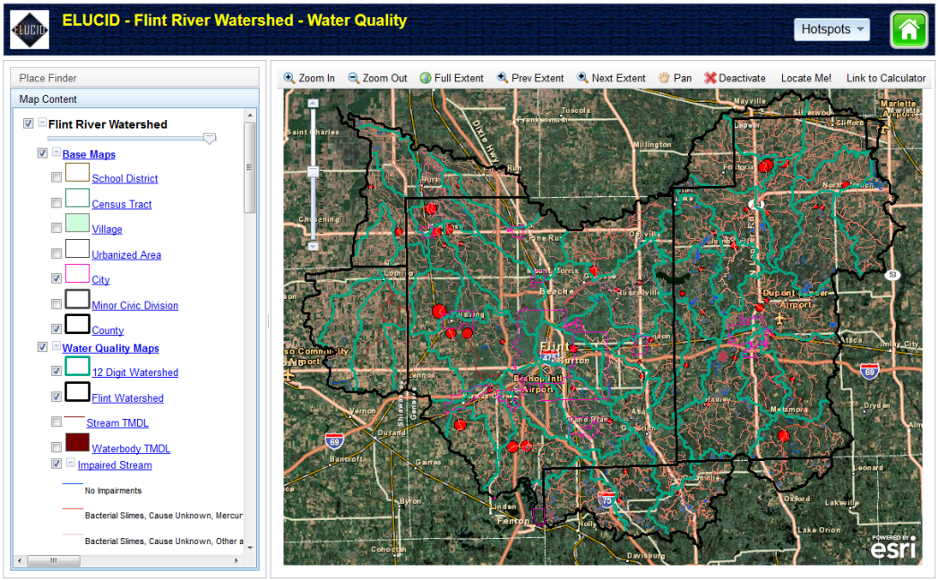
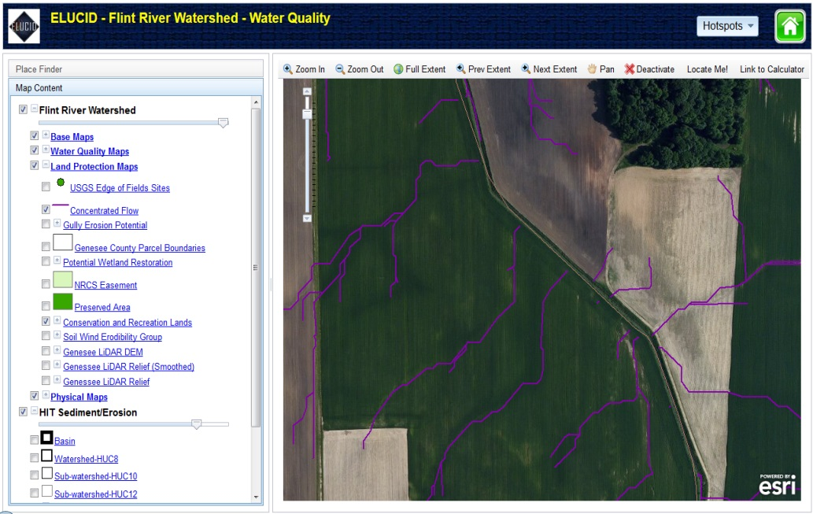
ELUCID Decision Support System
Environmental Learning Using Computer Interactive Decisions
Engage and inform various user groups
Linked with other systems
Notes:
One of ELUCID's greatest assets is its ability to engage and inform different user groups and address multiple issues in one system.
stronger, better organized network of technical experts, thus improving efficiency and effectiveness of executing programs to meet water quality improvement goals.
Furthermore, ELUCID can be linked to existing systems to enhance its analytical capabilities
The anticipated result is that students will become more responsive within their community as they see their community’s effort to protect local waters and ultimately, the Great Lakes

Slide 6
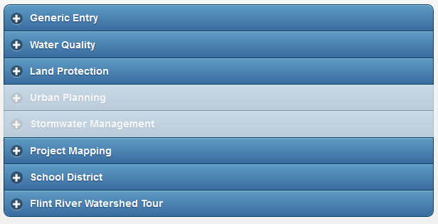
ELUCID Decision Support System
Notes:
ELUCID is currently focused on the Flint River Watershed. However, it does have a high-risk sediment layer that is available Saginaw Bay wide. We are open to expanding the system and would gladly discuss such opportunities with interested parties.
Here is a list of the themes housed in ELUCID, developed with input from our Advisory Team. Please note I’ll be covering each of these in more detail in a moment. Note that the ‘Water Quality’ theme is really the core of our project. The IWR felt it was important to also incorporate data on other “hot button” issues of our Advisory Team which is why you also see things such as Urban Planning on this list.

Slide 7
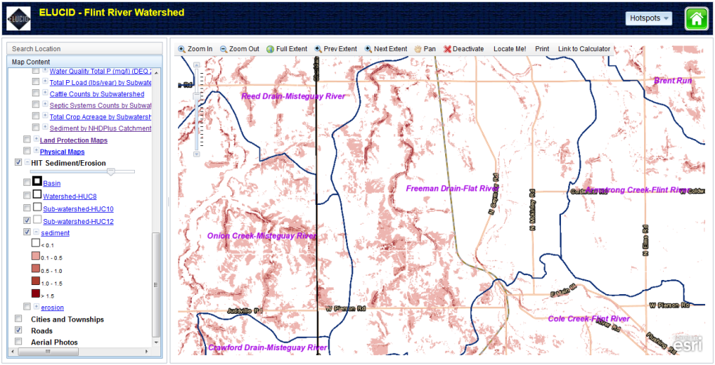
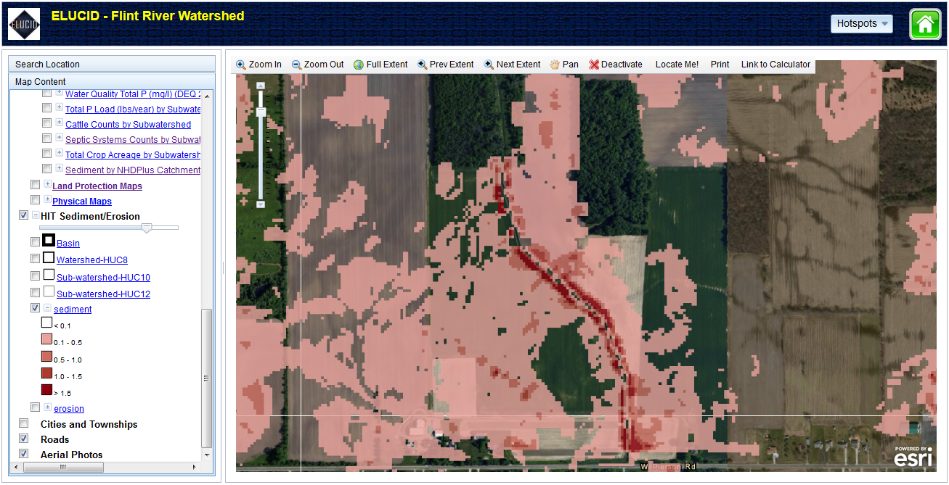
ELUCID Decision Support System
High risk mapping to target areas for conservation
HIT for erosion and sediment loading
Investigating similar data for SRP
Notes:
One of ELUCID's greatest assets is its ability to engage and inform different user groups and address multiple issues in one system.
stronger, better organized network of technical experts, thus improving efficiency and effectiveness of executing programs to meet water quality improvement goals.
Furthermore, ELUCID can be linked to existing systems to enhance its analytical capabilities
The anticipated result is that students will become more responsive within their community as they see their community’s effort to protect local waters and ultimately, the Great Lakes

Slide 8
ELUCID Decision Support System
Opportunities to expand ELUCID
Functionality
Geographic Areas
Themes
Audiences
Notes:
One of ELUCID's greatest assets is its ability to engage and inform different user groups and address multiple issues in one system.
stronger, better organized network of technical experts, thus improving efficiency and effectiveness of executing programs to meet water quality improvement goals.
Furthermore, ELUCID can be linked to existing systems to enhance its analytical capabilities
The anticipated result is that students will become more responsive within their community as they see their community’s effort to protect local waters and ultimately, the Great Lakes

Slide 9
Project Website and Forum
www.iwr.msu.edu/flintriver
Leave us feedback!

Slide 10
ELUCID Walkthrough

Slide 11
Tutorial

Slide 12
http://tinyurl.com/May2014ELUCID

